Slide 1
Software Testing
Continued...
Rajib Mall
CSE Department
IIT KHARAGPUR

Slide 2
Special Value Testing

Slide 3
Special Value Testing
What are special values?
  The tester has reasons to believe that execution with certain values may expose bugs:
  General risk: Example-- Boundary value testing
  Special risk: Example-- Leap year not considered

Slide 4
Boundary Value Analysis
Some typical programming errors occur:
  At boundaries of equivalence classes
  Might be purely due to psychological factors.
Programmers often fail to see:
  Special processing required at the boundaries of equivalence classes.

Slide 5
Boundary Value Analysis
Programmers may improperly use < instead of <=
Boundary value analysis:
  Select test cases at boundaries of different equivalence classes.

Slide 6
Boundary Value Analysis: Guidelines
If an input condition specifies a range, bounded by values a and b:
  Test cases should be designed with value a and b, just above and below a and b.
If an input condition specifies a range of number values:
  Test cases should be exercise the minimum and maximum numbers. Values just above and below minimum and maximum are also to be tested.
Example 1: Integer D with input range [-3, 10],
  test values: -3, 10, 11, -2, 0
Example 2: Input in the range: [3,102]
  test values: 3, 102, -1, 200, 5

Slide 7
Boundary Value Testing Example
Process employment applications based on a person's age.
Notice the problem at the boundaries.
  Age "16" is included in two different equivalence classes (as are 18 and 55).
0-16 | Do not hire
16-18 | May hire on part time basis
18-55 | May hire full time
55-99 | Do not hire

Slide 8
Boundary Value Testing Example (cont)
If (applicantAge >= 0 && applicantAge <=16) hireStatus="NO";
If (applicantAge >= 16 && applicantAge <=18) hireStatus="PART";
If (applicantAge >= 18 && applicantAge <=55) hireStatus="FULL";
If (applicantAge >= 55 && applicantAge <=99) hireStatus="NO";

Slide 9
Boundary Value Testing Example (cont)
Corrected boundaries:
0–15 Don't hire
16–17 Can hire on a part-time basis only
18–54 Can hire as full-time employees
55–99 Don't hire
What about ages -3 and 101?
The requirements do not specify how these values should be treated.

Slide 10
Boundary Value Testing Example (cont)
The code to implement the corrected rules is:
  If (applicantAge >= 0 && applicantAge <=15) hireStatus="NO";
  If (applicantAge >= 16 && applicantAge <=17) hireStatus="PART";
  If (applicantAge >= 18 && applicantAge <=54) hireStatus="FULL";
  If (applicantAge >= 55 && applicantAge <=99) hireStatus="NO";
Special values on or near the boundaries in this example are {-1, 0, 1}, {14, 15, 16}, {17, 18, 19}, {54, 55, 56}, and {98, 99, 100}.

Slide 11
Boundary Value Analysis
Create test cases to test boundaries of equivalence classes

Slide 12
Example 1
For a function that computes the square root of an integer in the range of 1 and 5000:
  Test cases must include the values: {0,1,2,4999,5000,5001}.
1
5000

Slide 13
Example 2
Consider a program that reads the “age” of employees and computes the average age.
input (ages) → Program → output: average age
Assume valid age is 1 to 150
How would you test this?
  How many test cases would you generate?
  What type of test data would you input to test this program?

Slide 14
Boundary Value Analysis: Robustness
Numeric values are often entered as strings :
  Internally converted to numbers [int x = atoi(str);]
This conversion requires the program to distinguish between digits and non-digits
A boundary case to consider: Will the program accept / and : as digits?
Char
/ | 0 | 1 | 2 | 3 | 4 | 5 | 6 | 7 | 8 | 9 | :
47 | 48 | 49 | 50 | 51 | 52 | 53 | 54 | 55 | 56 | 57 | 58
ASCII

Slide 15
Some Limitations of Boundary Value Testing
How to handle set of values?
May be set of boolean variables
  True
  False
  (these may be radio buttons)
What about non-numerical variable where the values may be text?

Slide 16
Quiz: BB Test Design
Design black box test suite for a function that solves a quadratic equation of the form ax²+bx+c=0.
Equivalence classes
  Invalid Equation
  Valid Equation: Roots?
Complex
Real
Coincident
Unique

Slide 17
Decision table-based Testing (DTT)
Applicable to requirements involving conditional actions.
Can be automatically designed
  Conditions = inputs
  Actions = outputs
  Rules =test cases
Assume independence of inputs
Example
  If c1 AND c2 OR c3 then A1
 | Rule1 | Rule2 | Rule3 | Rule4
Condition1 | Yes | Yes | No | No
Condition2 | Yes | X | No | X
Condition3 | No | Yes | No | X
Condition4 | No | Yes | No | Yes
Action1 | Yes | Yes | No | No
Action2 | No | No | Yes | No
Action3 | No | No | No | Yes

Slide 18
Combinations
 | Rule1 | Rule2 | Rule3 | Rule4
Condition1 | Yes | Yes | No | No
Condition2 | Yes | X | No | X
Condition3 | No | Yes | No | X
Condition4 | No | Yes | No | Yes
Action1 | Yes | Yes | No | No
Action2 | No | No | Yes | No
Action3 | No | No | No | Yes
Conditions
Actions

Slide 19
Sample Decision table
A decision table consists of a number of columns (rules) that comprise all test situations
Action a_{i} will take place if c1 and c2 are true
Example: the triangle problem
  C1: a, b,c form a triangle
  C2: a=b
  C3: a= c
  C4: b= c
  A1: Not a triangle
  A2:scalene
  A3: Isosceles
  A4:equilateral
  A5: impossible
 | r1 | r2 | … |  |  |  | rn
C1 | 0 | 1 |  |  |  |  | 0
c2 | - | 1 |  |  |  |  | 0
C3 | - | 1 |  |  |  |  | 1
C4 | - | 1 |  |  |  |  | 0
a1 | 1 | 0 |  |  |  |  | 0
a2 | 0 | 0 |  |  |  |  | 1
a3 | 0 | 0 |  |  |  |  | 0
a4 | 0 | 1 |  |  |  |  | 0
a5 | 0 | 0

Slide 20
Test cases from Decision Tables
Test Case ID | a | b | c | Expected output
TC1 | 4 | 1 | 2 | Not a Triangle
TC2 | 2888 | 2888 | 2888 | Equilateral
TC3 | ? | | | ) | Impossible
TC4
…
TC11

Slide 21
Decision Table for the Triangle Problem
Conditions
C1: a < b+c? | F | T | T | T | T | T | T | T | T | T | T
C2: b < a+c? | - | F | T | T | T | T | T | T | T | T | T
C3: c < a+b? | - | - | F | T | T | T | T | T | T | T | T
C4: a=b? | - | - | - | T | T | T | T | F | F | F | F
C5: a=c? | - | - | - | T | T | F | F | T | T | F | F
C6: b-c? | - | - | - | T | F | T | F | T | F | T | F
Actions
A1: Not a Triangle | X | X | X
A2: Scalene |  |  |  |  |  |  |  |  |  |  | X
A3: Isosceles |  |  |  |  |  |  | X |  | X | X
A4: Equilateral |  |  |  | X
A5: Impossible |  |  |  |  | X | X |  | X

Slide 22
Test Cases for the Triangle Problem
Case ID | a | b | c | Expected Output
DT1 | 4 | 1 | 2 | Not a Triangle
DT2 | 1 | 4 | 2 | Not a Triangle
DT3 | 1 | 2 | 4 | Not a Triangle
DT4 | 5 | 5 | 5 | Equilateral
DT5 | ? | ? | ? | Impossible
DT6 | ? | ? | ? | Impossible
DT7 | 2 | 2 | 3 | Isosceles
DT8 | ? | ? | ? | Impossible
DT9 | 2 | 3 | 2 | Isosceles
DT10 | 3 | 2 | 2 | Isosceles
DT11 | 3 | 4 | 5 | Scalene

Slide 23
Decision Table – Example 2
Conditions | Printer does not print | Y | Y | Y | Y | N | N | N | N
 | A red light is flashing | Y | Y | N | N | Y | Y | N | N
 | Printer is unrecognized | Y | N | Y | N | Y | N | Y | N
Actions | Check the power cable |  |  | X
 | Check the printer-computer cable | X |  | X
 | Ensure printer software is installed | X |  | X |  | X |  | X
 | Check/replace ink | X | X |  |  | X | X
 | Check for paper jam |  | X |  | X
Printer Troubleshooting

Slide 24
Quiz: Develop BB Test Cases
Policy for charging customers for certain in-flight services:
  If the flight is more than half-full and ticket cost is more than Rs. 3000, free meals are served unless it is a domestic flight. The meals are charged on all domestic flights.

Slide 25
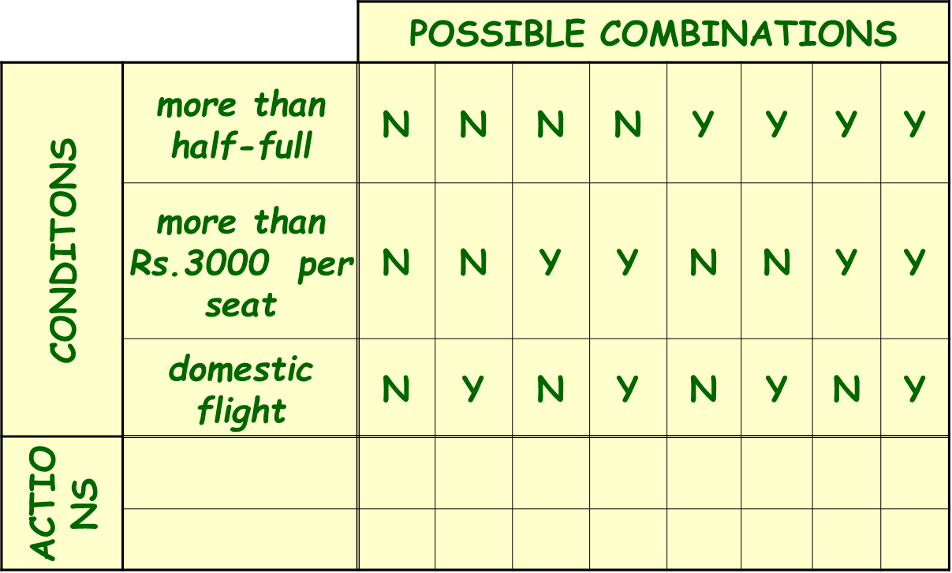
Fill all combinations in the table.

Slide 26
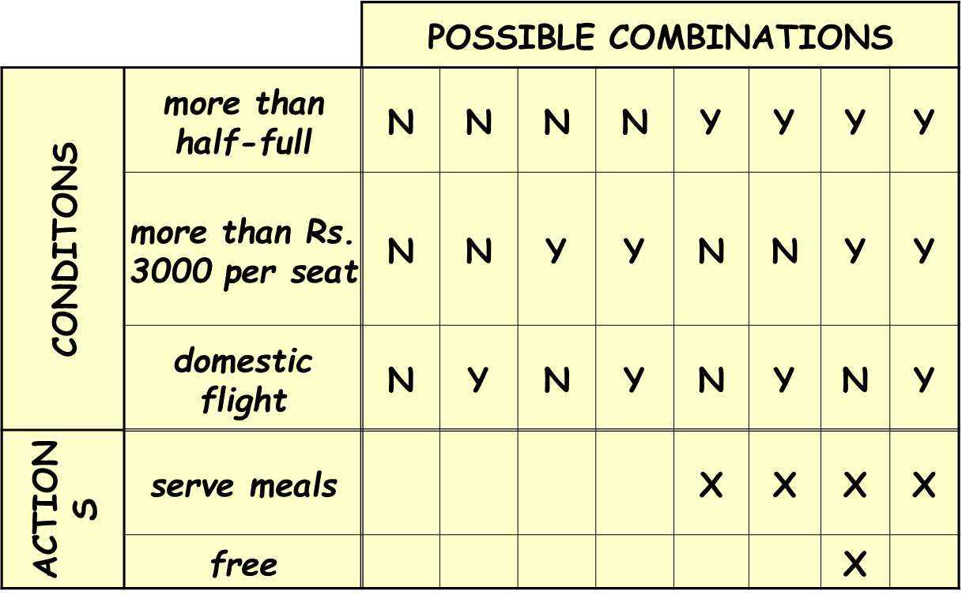
Analyze column by column to determine which actions are appropriate for each combination

Slide 27
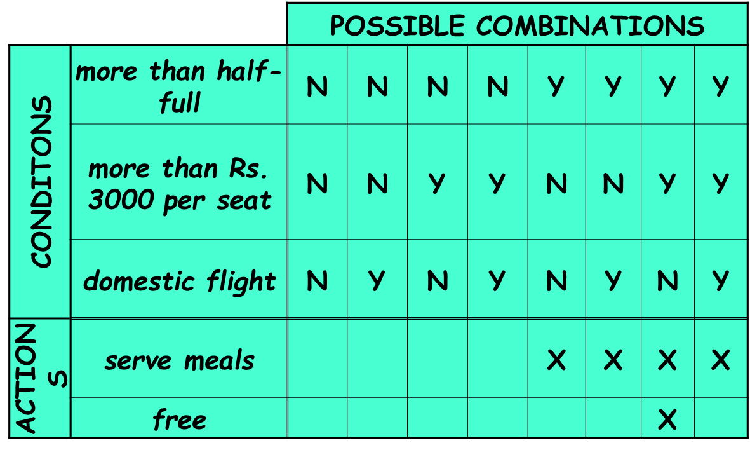
Reduce the table by eliminating redundant columns.

Slide 28
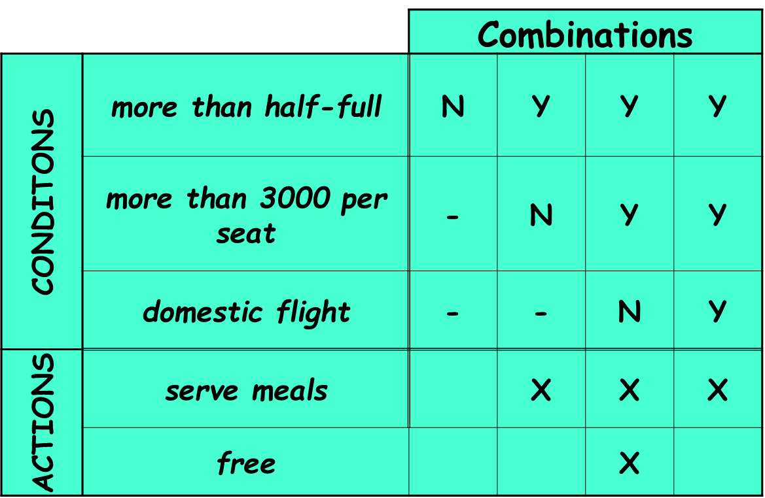
Final solution

Slide 29
Assumptions regarding rules
  Rules need to be complete:
    That is, every combination of decision table values including default combinations are present.
  Rules need to be consistent:
    That is, there is no two different actions for the same combinations of conditions

Slide 30
Guidelines and Observations
Decision Table testing is most appropriate for programs for which:
  There is a lot of decision making
  There are important logical relationships among input variables
  There are calculations involving subsets of input variables
  There are cause and effect relationships between input and output
  There is complex computation logic
Decision tables do not scale up very well

Slide 31
Quiz: Design test Cases
Customers on a e-commerce site get following discount:
  A member gets 10% discount for purchases lower than Rs. 2000, else 15% discount
  Purchase using SBI card fetches 5% discount
  If the purchase amount after all discounts exceeds Rs. 2000/- then shipping is free.

